Slide 1
DBS152 – Introduction to Database
Week 2: Lesson 3

Slide 2
Data modelling and logical database design Lesson 3: Relational Data Models

Slide 3
Objective:
Learn about the relational data model, which is one of the most commonly used approaches for structuring data.
Understand how relational databases use tables, keys, and relationships to organize data.

Slide 4
Content
Relational Data Model
What is a Relational Data Model?
Key Concepts:
Creating a Relational Database Schema:
Example of a Relational Database:
Why is the Relational Model Important?
Summary
Activity

Slide 5
Relational Data Model
The relational data model is one of the most widely used approaches for structuring and organizing data in databases. It is foundational in modern database management systems, providing a method for data to be stored in a way that allows for easy querying, updates, and integrity checks.

Slide 6
2. What is a Relational Data Model?
A relational data model structures data in tables (also known as relations). These tables contain rows and columns where:
Rows represent individual records (or tuples).
Columns represent the attributes (or fields) of the records.
Tables can relate to one another through the use of keys, which are used to establish connections between different entities (or tables) and maintain referential integrity.
Key components of the relational data model:
Tables (relations)
Keys (primary and foreign)
Normalization

Slide 7
3. Key Concepts:
1. Tables (Relations):
A table in a relational database is essentially a collection of rows and columns, where:
Rows (Tuples): Represent individual data records. For example, in a Students table, each row might represent a student.
Columns (Attributes): Represent the properties of each record. In the Students table, these columns might include Student_ID, Name, and Age.

Slide 8
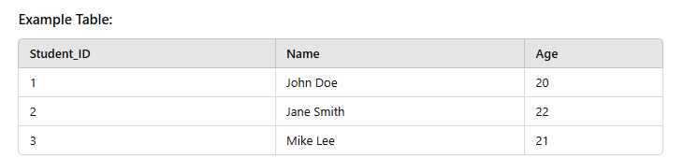

Slide 9
Primary Key (PK):
A primary key is a unique identifier for each record (row) in a table. It ensures that each record in the table is identifiable by a unique value.
Each table must have a primary key.
No two rows in a table can have the same primary key value.
Example:
In a Students table, Student_ID could be the primary key, as each student has a unique ID number.

Slide 10
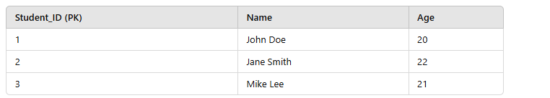

Slide 11
Foreign Key (FK):
A foreign key is a field in one table that is used to reference the primary key of another table. This establishes a relationship between the two tables.
The foreign key helps to maintain referential integrity—ensuring that data is consistent and related across tables.
Example: In a Courses table, Student_ID could be a foreign key that links to the Student_ID in the Students table, showing which student is enrolled in which course.

Slide 12
Normalization:
Normalization is the process of organizing data in such a way that redundancy is minimized, and data dependencies are properly enforced. It involves dividing large tables into smaller, more manageable ones and defining relationships between them.
There are several normal forms (1NF, 2NF, 3NF, etc.), each addressing specific issues of redundancy and dependency. The process helps to ensure the database is free from anomalies (e.g., insertion, update, and deletion anomalies).
1st Normal Form (1NF): Ensures that each column contains atomic (indivisible) values, and each record is unique.
2nd Normal Form (2NF): Ensures that all non-key attributes are fully dependent on the primary key (eliminating partial dependency).
3rd Normal Form (3NF): Ensures that non-key attributes are not dependent on other non-key attributes (eliminating transitive dependency).

Slide 13
4. Creating a Relational Database Schema:
A relational database schema defines how data is organized within a relational database. The schema includes the definitions of tables, columns, primary keys, and relationships.
Define the Tables: Identify the entities in your system and create a table for each. Each table will represent an entity, such as Students, Courses, Enrollments.
Identify Primary Keys: For each table, select a column (or a combination of columns) that uniquely identifies each row. For example, Student_ID might be the primary key for the Students table.
Define Foreign Keys: Identify relationships between tables and link them using foreign keys. For instance, an Enrollments table could link the Students and Courses tables using Student_ID and Course_ID as foreign keys.

Slide 14
Implement Relationships: Use foreign keys to establish different types of relationships:
One-to-Many: One row in a table relates to many rows in another table (e.g., One student can enroll in many courses).
Many-to-Many: Multiple rows in one table relate to multiple rows in another (e.g., Many students can enroll in many courses). This relationship is typically modeled using a third table, such as Enrollments.

Slide 15
5. Example of a Relational Database:
Example of a Relational Database Schema
Consider a system for a university with the following tables:
Students
Courses
Enrollments

Slide 16
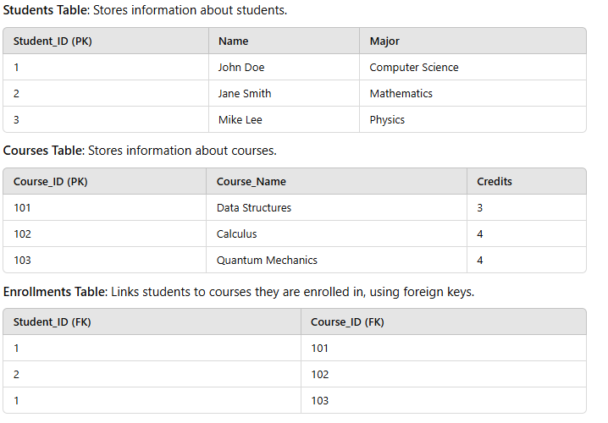

Slide 17
In this schema:
The Students table has Student_ID as its primary key.
The Courses table has Course_ID as its primary key.
The Enrollments table links the two with foreign keys Student_ID and Course_ID, creating a many-to-many relationship between students and courses.

Slide 18
6. Why is the Relational Model Important?
1.Data Integrity: The relational model enforces integrity through primary and foreign keys, ensuring data consistency and eliminating duplicate or orphaned records.
2.Flexibility: It allows for flexibility in adding new tables, attributes, or relationships without disrupting the entire database structure.
3. Scalability: Relational databases can scale efficiently by indexing data and optimizing queries.
4. Reduced Redundancy: Normalization ensures that data is not repeated unnecessarily, saving storage space and improving efficiency.
5. Ease of Use: The relational model uses a simple table-based format, which is easy to understand and interact with using SQL (Structured Query Language).

Slide 19
7. Summary
The relational data model provides a systematic way of organizing data into tables with well-defined relationships using keys. By leveraging primary keys, foreign keys, and normalization, it ensures that data is structured efficiently, with minimal redundancy and maximum integrity.
In this lesson series, you have explored:
Data Modeling: The foundation of structuring and organizing data.
Conceptual Modeling: High-level visualization of how entities are related.
Relational Data Models: The practice of organizing data into tables with keys and relationships to ensure integrity, minimize redundancy, and provide flexibility in queries.
These concepts form the backbone of modern database design and are essential for anyone involved in database management or development. Understanding the relational model is key to building scalable, efficient, and reliable database systems.

Slide 20
8. Activity
1.Define a relational data model and explain its key components.
2.What is the difference between a primary key and a foreign key?
3.Explain normalization and why it is important in a relational database.
4.How does a many-to-many relationship work in a relational database? Provide an example.
5.Describe the steps involved in creating a relational database schema for a university system with Students and Courses.

Slide 21
Solutions
1. Define a relational data model and its key components.
A relational data model organizes data into tables (relations) consisting of rows (records) and columns (attributes).
Key Components:
Tables (Relations): Store data in structured form.
Primary Key: Unique identifier for each row.
Foreign Key: Field linking two tables.
Normalization: Process to minimize redundancy

Slide 22
2. Difference between a primary key and a foreign key?
Primary Key: Uniquely identifies each record in a table. Example: Student_ID in a Students table.
Foreign Key: References a primary key in another table to establish a relationship. Example: Student_ID in an Enrollments table referencing Student_ID in the Students table.
3. What is normalization and why is it important?
Normalization is the process of organizing data in a database to reduce redundancy and dependency.
It ensures data integrity, minimizes data anomalies, and optimizes storage.

Slide 23
4. How does a many-to-many relationship work in a relational database?
A many-to-many relationship is implemented using a junction table (bridge table).
Example: Students and Courses have a many-to-many relationship. The Enrollments table is used to link them:
Student_ID (FK) → References Students table.
Course_ID (FK) → References Courses table.

Slide 24
5. Steps to create a relational database schema for a university system:
Identify entities (Students, Courses, Enrollments).
Define tables for each entity.
Choose primary keys (e.g., Student_ID for Students).
Establish foreign keys (e.g., Student_ID in Enrollments linking to Students).
Implement relationships (one-to-many or many-to-many).

Slide 25



